Slide 1
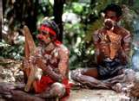
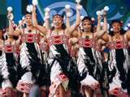
The Aborigines

Slide 2
Formation of Australia
Sixty thousand years ago, there was an Ice Age on Earth.
Much of the world’s water was frozen in glaciers. This made the sea level drop.
The land that was under water eventually became exposed.
Australia, New Guinea, and Tasmania all formed one huge land mass called Sahul.

Slide 3
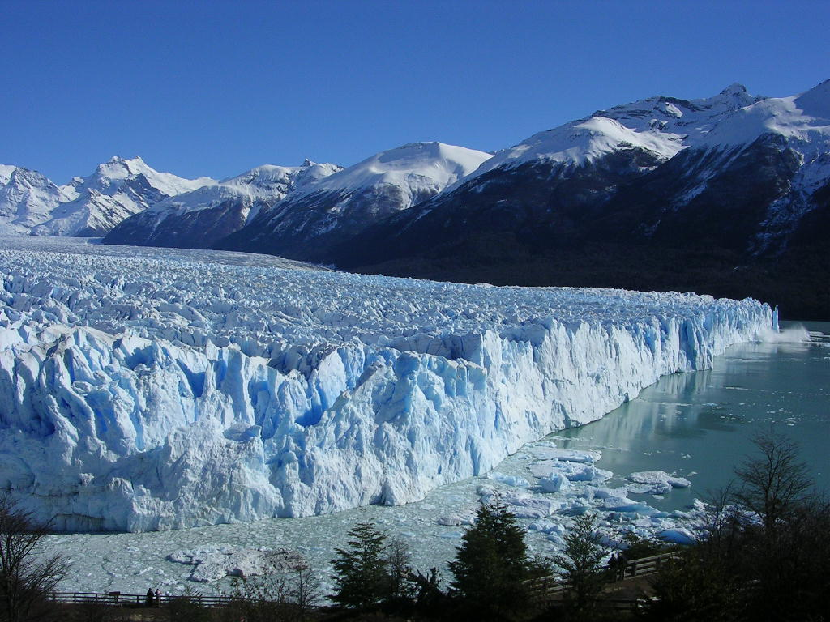

Slide 4
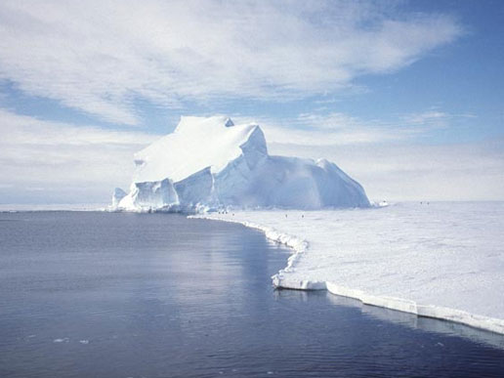

Slide 5
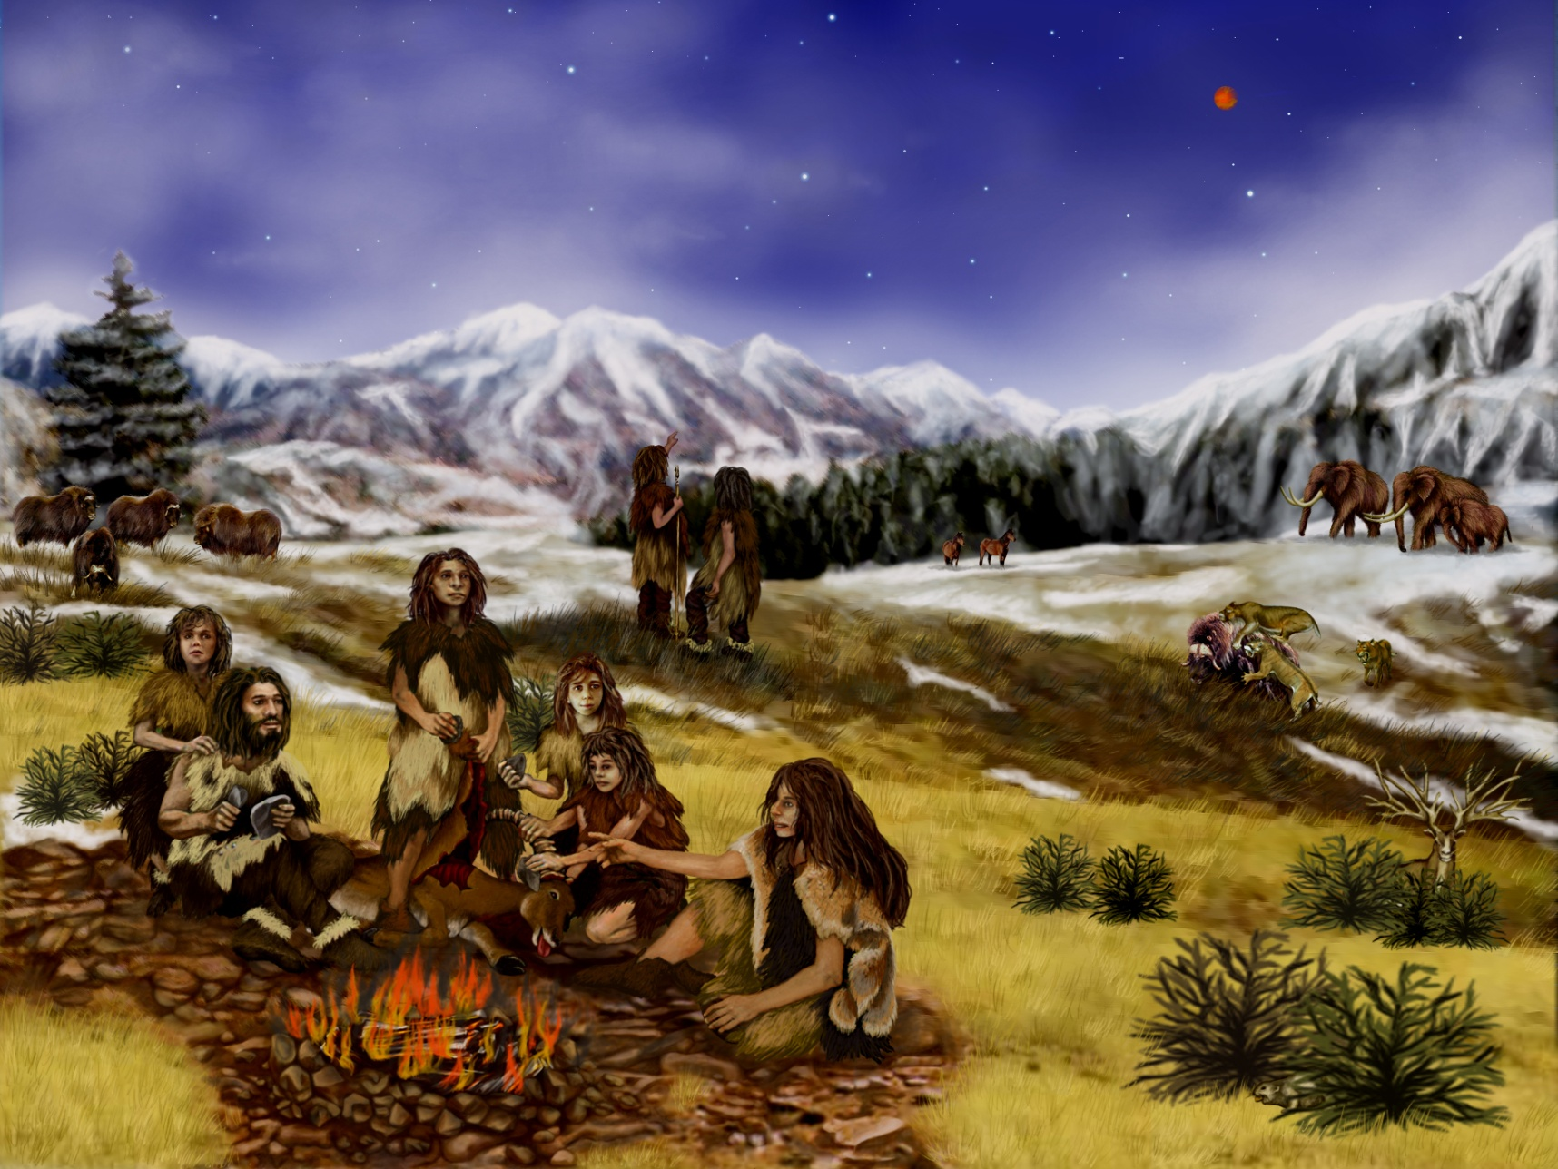
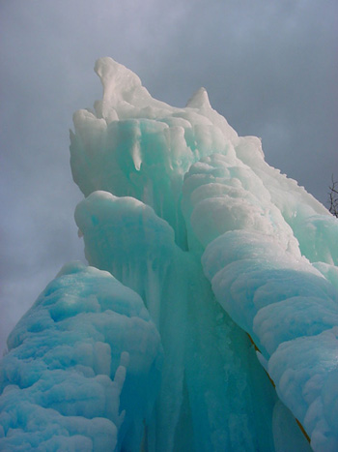
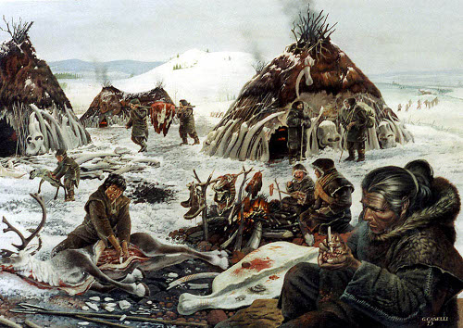

Slide 6
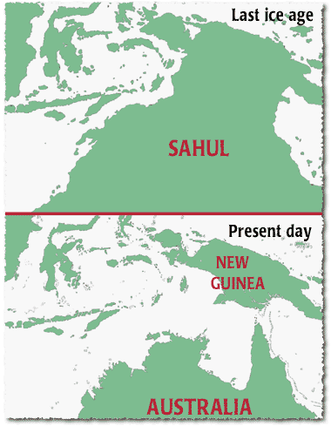

Slide 7
The first people came to Australia at this time.
They came from Southeast Asia.
They traveled in boats from island to island.

Slide 8
The most recent Ice Age ended 10,000 years ago.
People had spread all over Sahul.
Glaciers melted and sea levels rose.

Slide 9
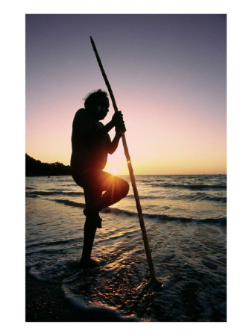
Higher water cut off Australia from New Guinea and Tasmania.
They became three
different islands. Miles of
ocean separated them.
The residents had no
contact with the rest of
the world for thousands
of years.

Slide 10
The Australian Aborigine
The first people to live in Australia are called Australian Aborigines.
The first Aborigines lived on the coast.

Slide 11
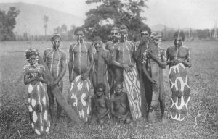
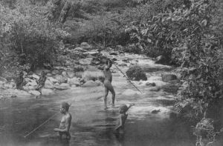
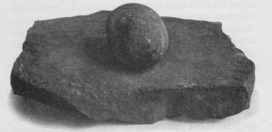

Slide 12
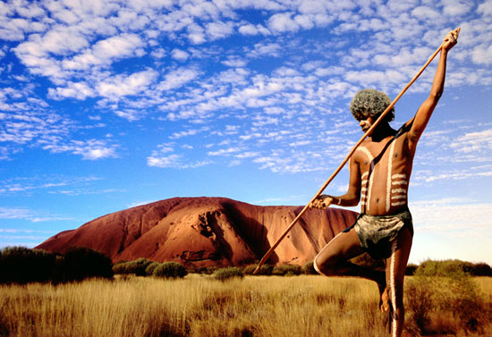
Inner Australia was a huge desert.
On the coast, there were more plants growing.
There were also more animals to hunt & fresh water.

Slide 13
Aborigines lived in small groups.
They were larger in the coastal areas and smaller in the interior.

Slide 14
There were strict rules on how groups interacted.
However, there was no specific leader in the group.
All members were equal.

Slide 15
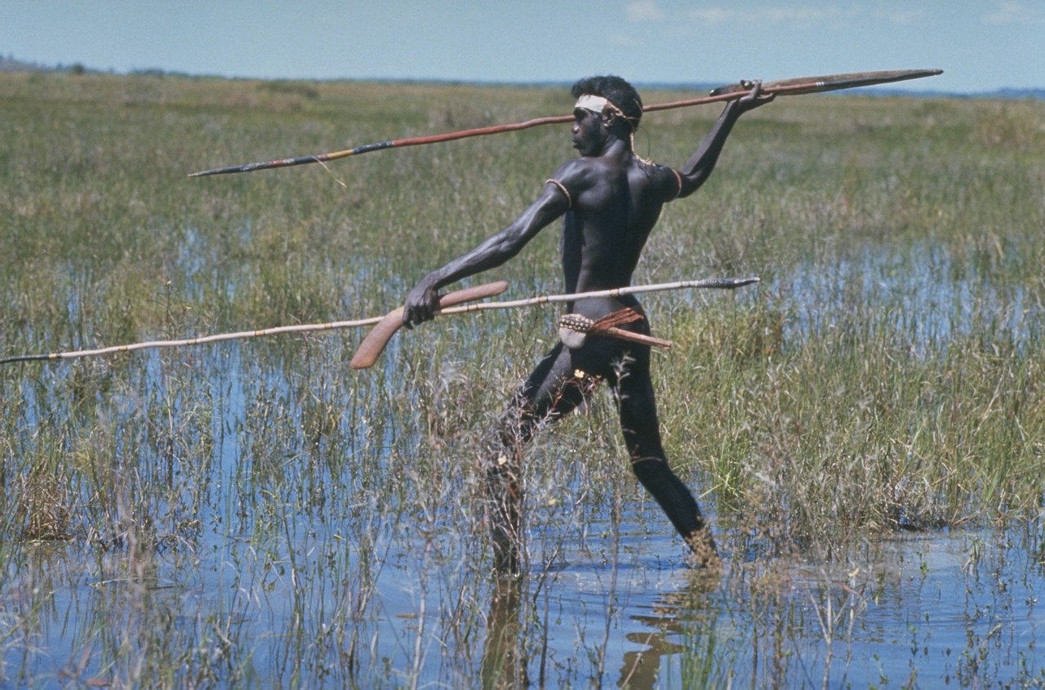
There may have been about 500 groups of Aborigines
and more than
200 languages.
Aborigines were
hunter-gathers.

Slide 16
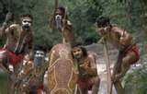
What they ate depended on where they lived.
Different food was available on different parts of the island.

Slide 17
Aborigines never grew their own food.
Instead, they survived on whatever grew naturally by understanding how to live in different natural environments.

Slide 18
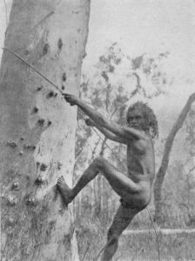
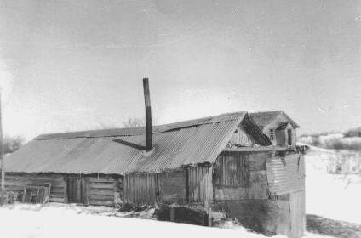
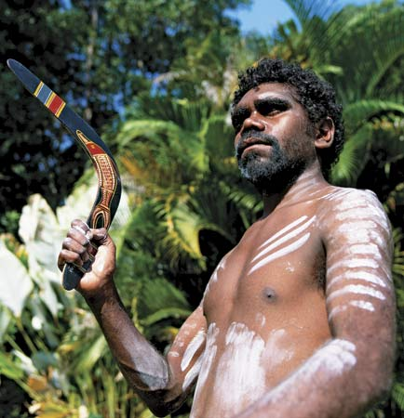

Slide 19
Barter
Australian Aborigines also bartered with one another.
Bartering diversified the type of goods available.

Slide 20
Trade also kept different groups of Aborigines connected to one another.
This contact helped keep the culture of different groups similar.

Slide 21
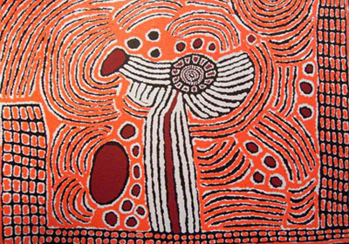
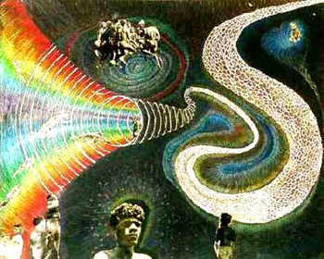
Dreamtime
Living things were created by ancient spirit ancestors.
These stories of creation are known as the Dreamtime, or Dreaming.
Explains the creation of the earth and how all living things were created

Slide 22
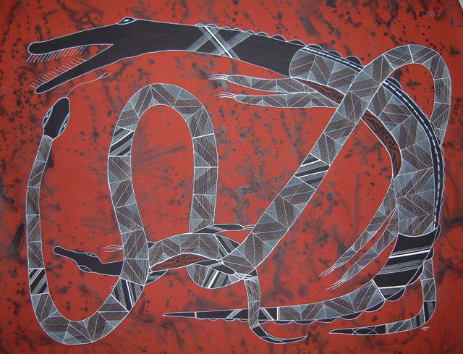
Aboriginal paintings dating back more than 6000 years depict numerous Dreamtime stories
One of the most well known is the story of the Rainbow Serpent.

