Slide 1
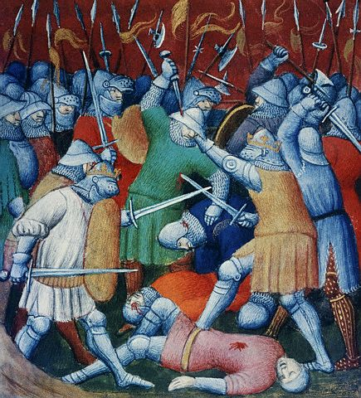
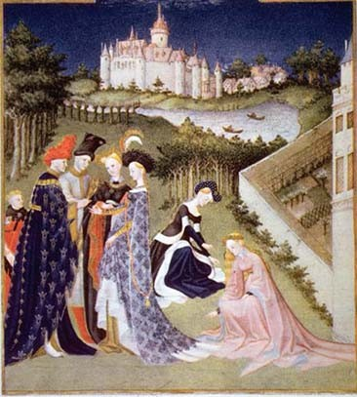
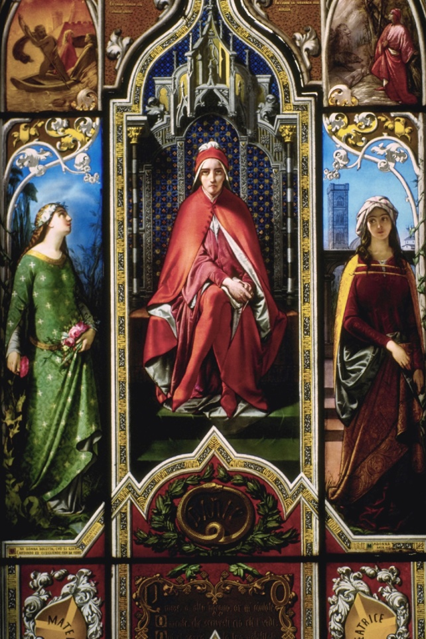
Introduction to Europe’s History

Slide 2
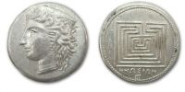
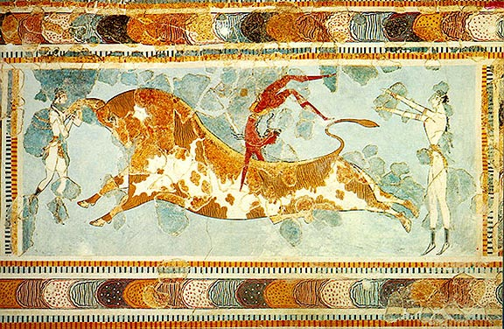
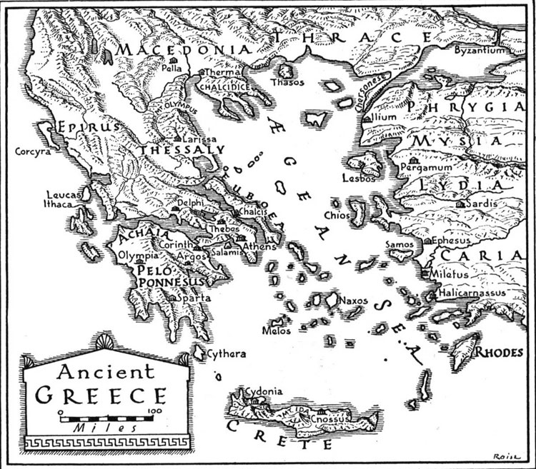
Greek Empire
The Greek Empire was centered around the Mediterranean Sea and was made up of several city-states, the most famous being Athens and Sparta.
City-states are cities that are also independent nations.

Slide 3
Sparta
Athens
The city was clean and beautiful.
Education was based on mostly mental skills.
The citizenship was free.
The courts were chosen by a lot of juries.
Culture was included fine art and had a lot of theater.
The city was dirty and lacked beauty.
Education was based on military skills.
The citizenship was strict.
Judges were kings.
The culture lacked art and was based on a military theme.
All of the cities were in ancient Greece.
Both cities had slaves.
Slaves were not considered citizens.

Slide 4
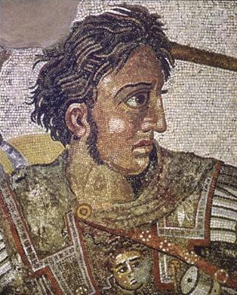
Alexander the Great
son of King Philip of Macedonia
set out to conquer the world
brought Greek ideas and culture to the lands he conquered
  Persia (present-day Iran)
  parts of Egypt
  parts of India
His empire split up after
his death at age 33.

Slide 5
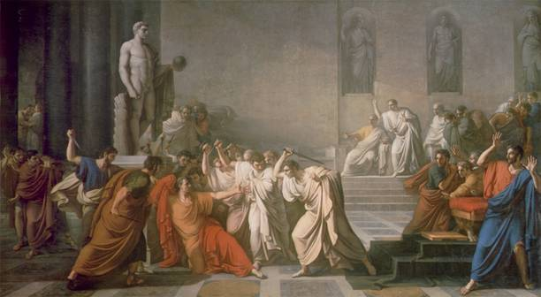
Roman Republic
In the Roman Republic, laws were created by elected representatives.
Roman armies were very powerful and they conquered many people and lands, including present-day Spain and United Kingdom.
Julius Caesar, one of
the most famous
Roman generals,
became the leader
of the Roman Republic.
Fearing Julius
Caesar’s power,
some senators
murdered him.
Caesar’s murder began a Roman civil war.

Slide 6
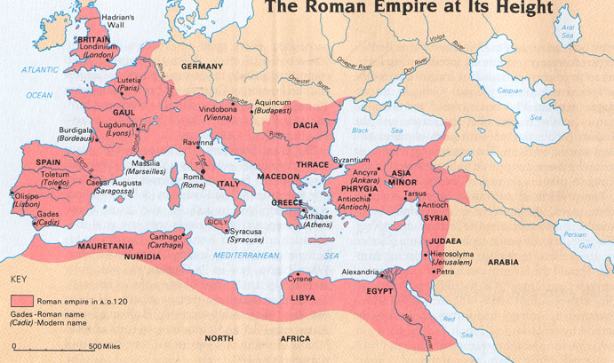

Slide 7
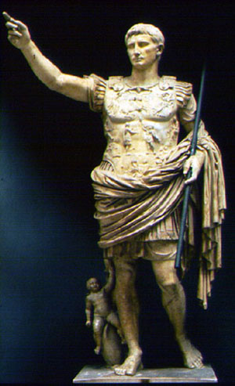
The Roman Empire
The civil wars ended with Octavian becoming head of the Roman Empire. He was Julius Caesar’s nephew.
The Roman people called him Octavian the Emperor Augustus.
His reign began 200 years of peace and growth known as the Pax Romana.

Slide 8
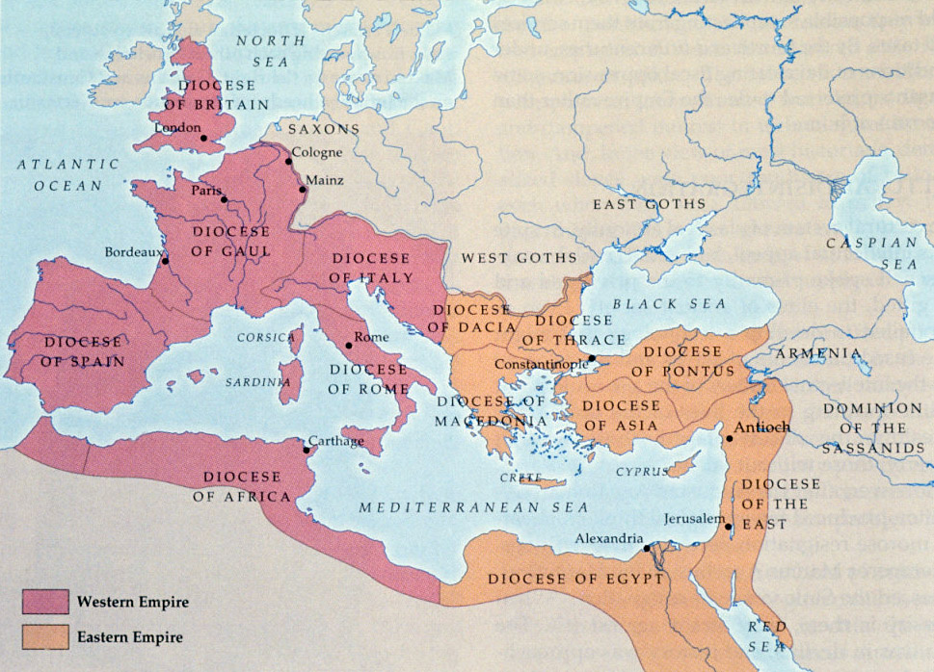
The Fall of the Roman Empire
Western Roman Empire
Eastern Roman Empire
Bands of Germans lived along the northern frontier of the Roman Empire. Rome called them barbarians.
They attacked and conquered the Western Roman Empire.
Vikings began sailing and sacking (attacking) the northern and western coasts of Europe, influencing culture in many parts of the world.
The Eastern Roman Empire fell 1,000 years after the Western Roman Empire (during the Crusades).

Slide 9
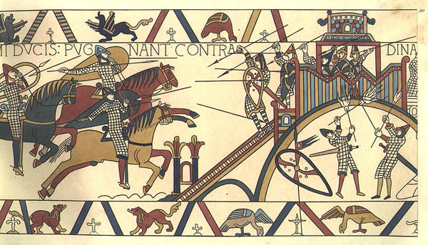
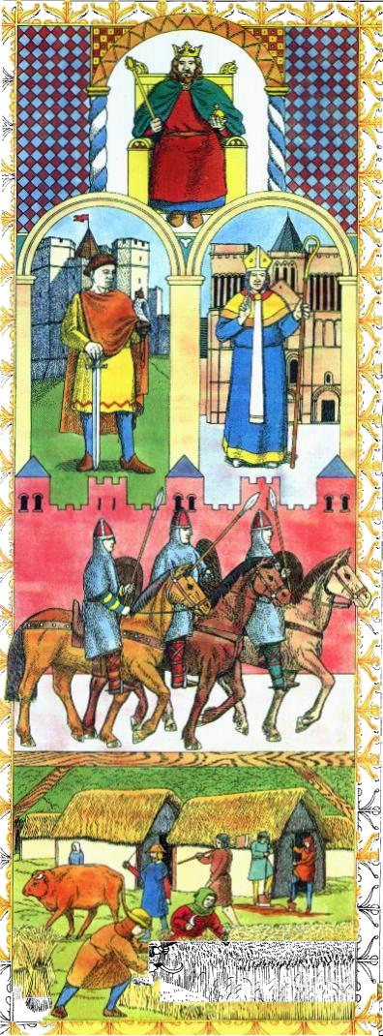
The Middle Ages
During the Middle Ages, many people lived under the feudal system.
In the feudal system, everyone had a place in society. Most medieval society was divided into three classes: nobles, clergy, and serfs.
Duke William of Normandy brought feudalism to England when he conquered the country in 1066. He became King William I of England.

Slide 10
The Crusades
They were holy wars between Christians and Muslims.
Christian crusaders fought to take Jerusalem from the Muslims.
The Christians won the Holy Land for a time, but the Muslims got it back.
The Crusaders brought back new ideas, new products, and new plans for trade in Europe.

Slide 11
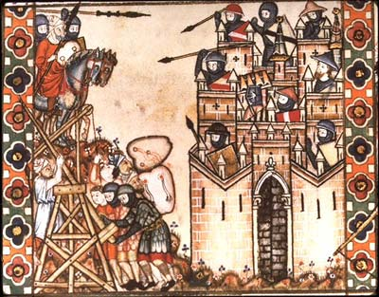

Slide 12
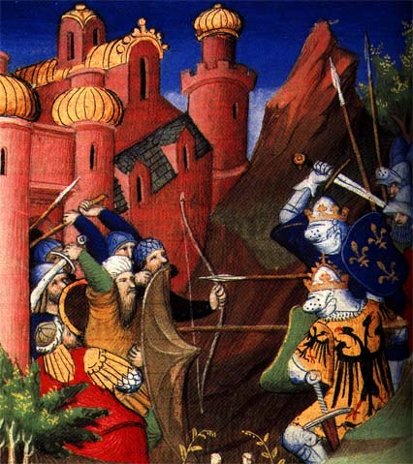

Slide 13
Growth of the Nation-state
France and England went to war for 116 years. There were short battles followed by long periods of cease fire.
When the 100 Years War began, it was a war between two kingdoms. When it was over, it had become a war between two countries.
The French and English monarchs used propaganda to create a sense of
us verses them, the beginnings of
nationalism.

Slide 14
The Black Plague 1347 - 1352
In 1348, a ship from the east docked in present-day Italy. Sick sailors came ashore, bringing the Black Plague with them.
The Black Plague got its name because it caused spots of blood to turn black under the skin.
Between 1/4 and 1/3 of Europe’s population died.
One result of the plague was a shortage of labor because there were less workers, wages increased for artisans and peasants.

Slide 15
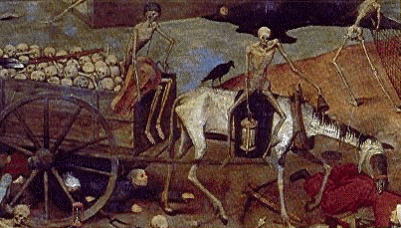
Medieval Art & the Plague
Bring out your dead!

Slide 16
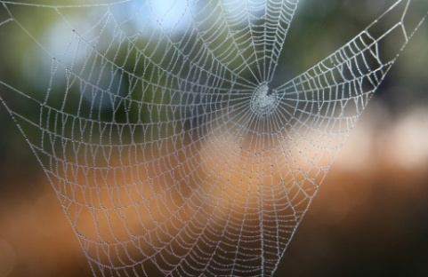
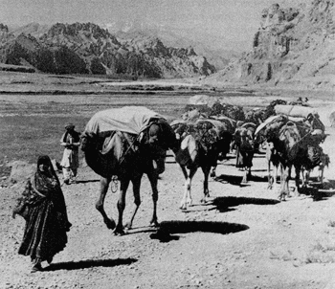
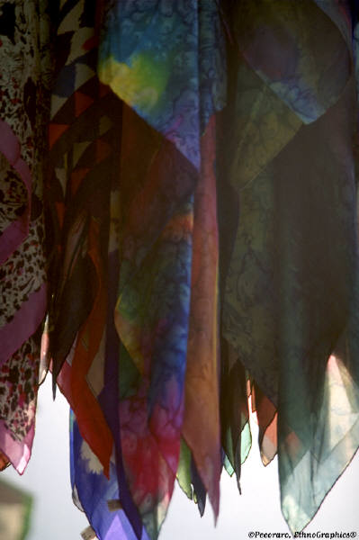
The Silk Road
China’s main link to the Western world
Traders brought Chinese goods to the West.
The Silk Road was not a one-way trade route.
Chinese products went to the West.
New ideas from the West,
India, and
Middle East flowed
into China (for
example, Buddhism
from India).

Slide 17
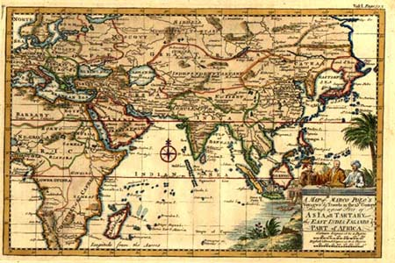

Slide 18
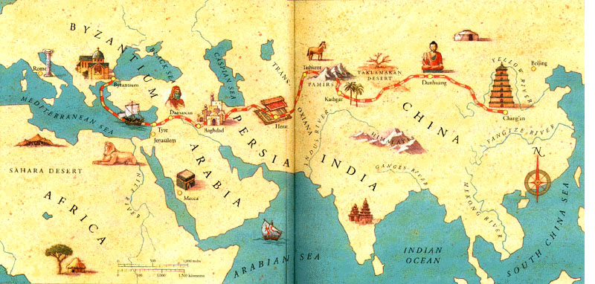

Slide 19
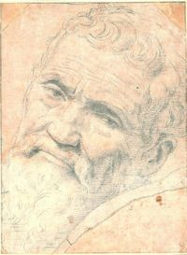
The Renaissance
Renaissance is French for “rebirth.”
Renaissance Europeans were interested in the art and ideas of the ancient Greeks and Romans
During the Renaissance, great work was done in art and in science. More books became available to more people due to the invention of the printing press.
Johann Gutenberg's printing press made the production of books easier and faster, thereby making books cheaper to buy.
Leonardo
Michelangelo
Galileo

Slide 20
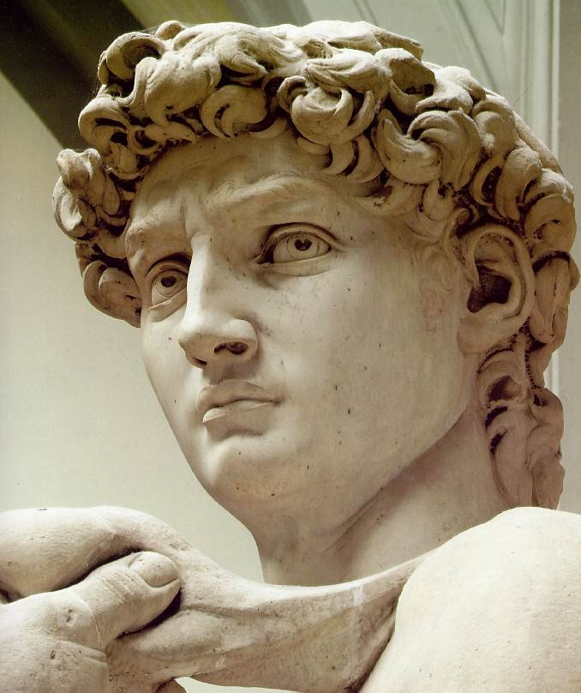
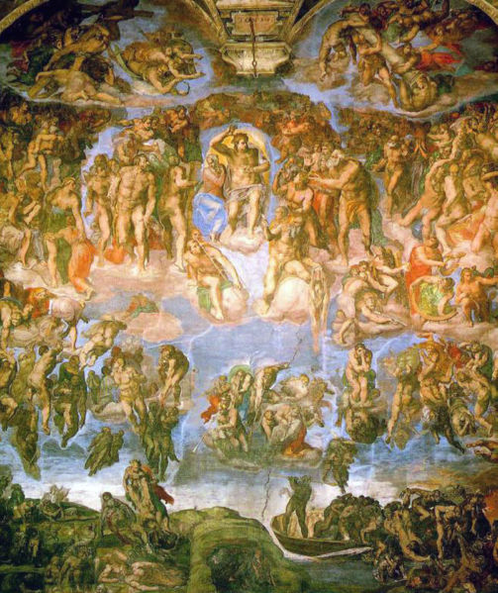
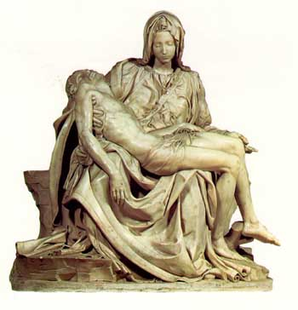
Michelangelo Buonarotti

Slide 21
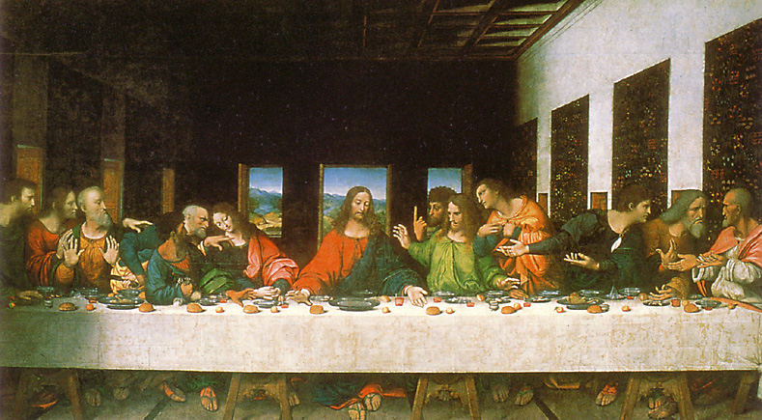
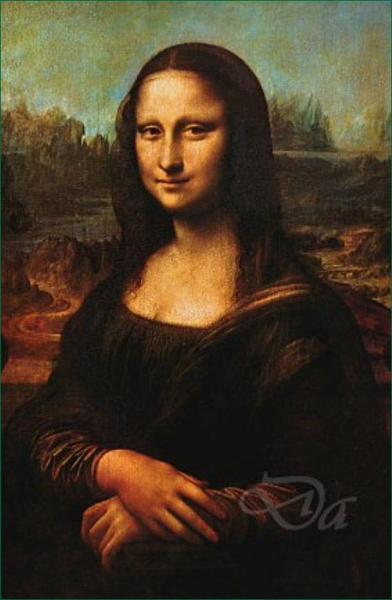
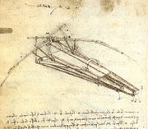
Leonardo da Vinci

Slide 22
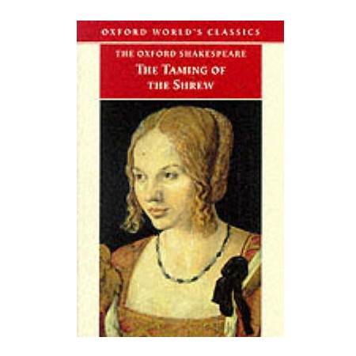
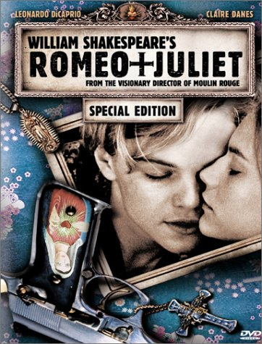
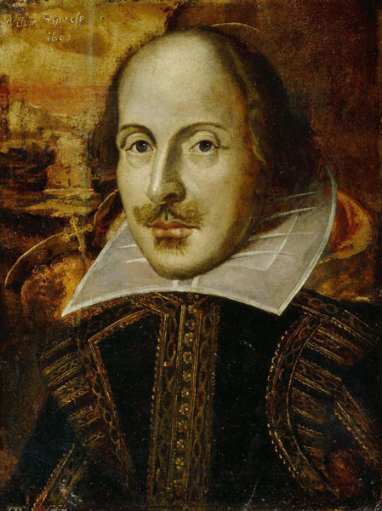
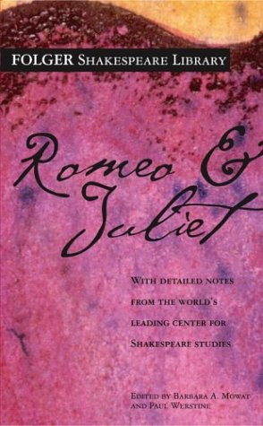

William Shakespeare

Slide 23
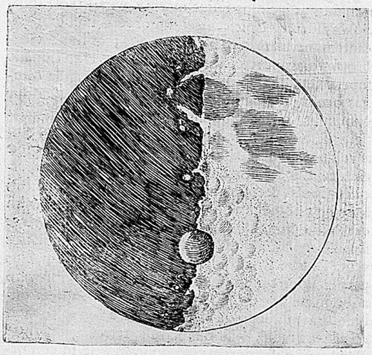
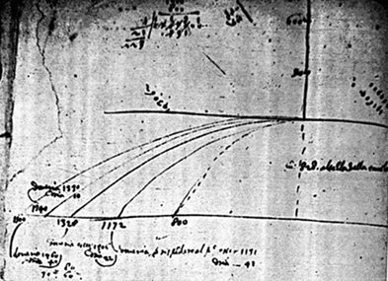
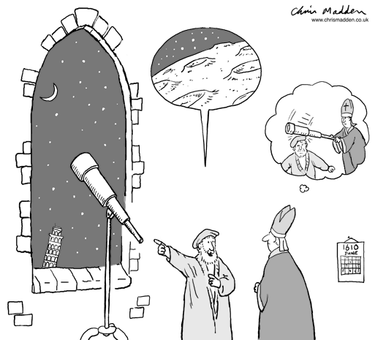
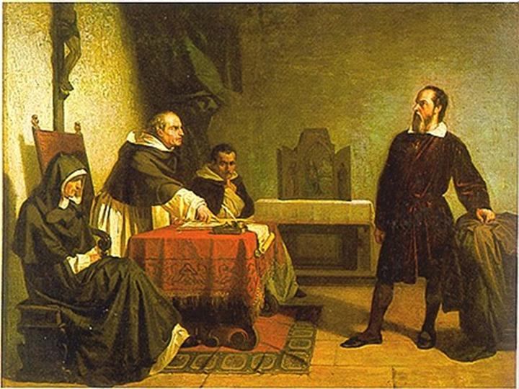
Galileo Galilei
Galileo made the claim that the Earth was not the center of the universe. The Catholic Church arrested him and made him recant his theory. Galileo was imprisoned in his home for the rest of his life.

Slide 24
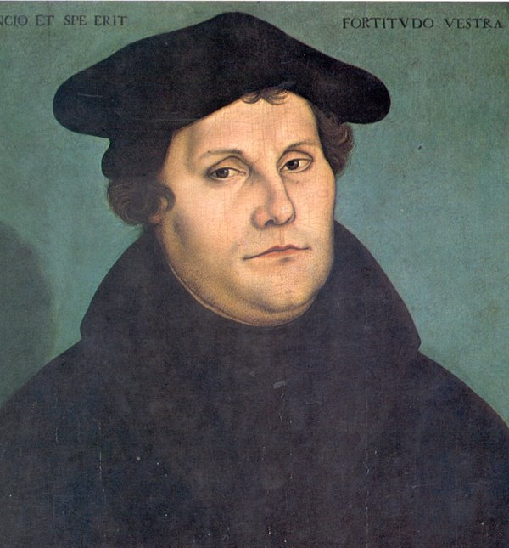
Protestant Reformation
During the Renaissance, some people began to question the practices of the Catholic Church. Martin Luther led the Protestant Reformation.

Slide 25
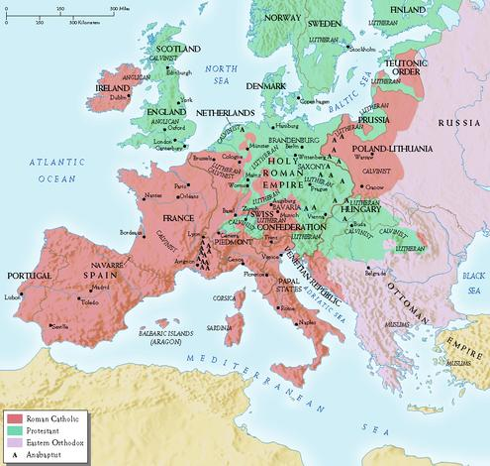
Protestant Reformation
Protestants (England, Netherlands, and the German states) and Roman Catholics (Spain, Portugal, France, and the Italian states) competed to control Europe.
This competition carried over into exploration.

